Slide 1

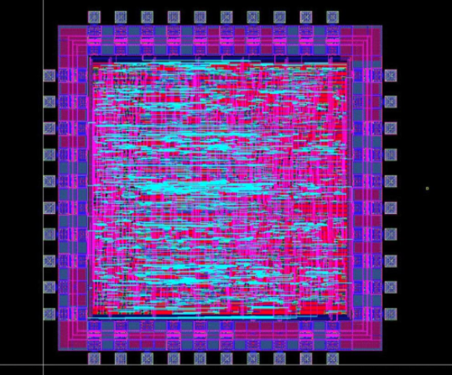
ECE 337 Project Canny Edge Detection Design Review
Oluwatosin Adeosun, Sukhyun Hong,
Eric Nielsen, Jiyuan Zhao

Slide 2
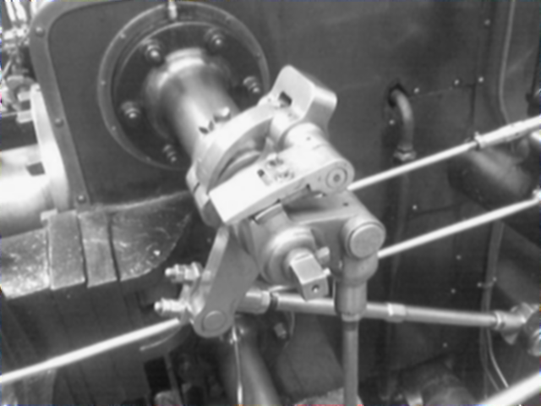
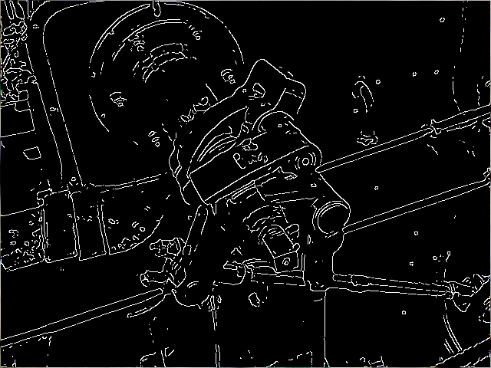
Project Overview
Edge detection using Canny algorithm
ASIC implementation using pipelining
Input/output bitmap images
Interfacing with off-chip SRAM
Four main functional blocks
Image smoothing
Gradient and magnitude calculation
Directional non-maximal suppression
Hysteresis thresholding

Slide 3
System Level Diagram
Output Image
(Bitmap, 512x512 pixels)
Python Script
Python Script
Input Image
(Bitmap, 512x512 pixels)
Off-Chip SRAM
(Cypress, CY7C1018DV33)
Read Input Image Data
(AHB-Lite Protocol)
Canny Edge Detection Algorithm
Write Output Image Data
(AHB-Lite Protocol)

Slide 4
Design Flow Chart
Magnitude Calculation Block
Directional Non-Maximal Suppression Block
Input Image
Data
Output Image Data
Image Smoothing Block (Gaussian)
Horizontal & Vertical Gradient Calculation Block
Hysteresis Thresholding

Slide 5
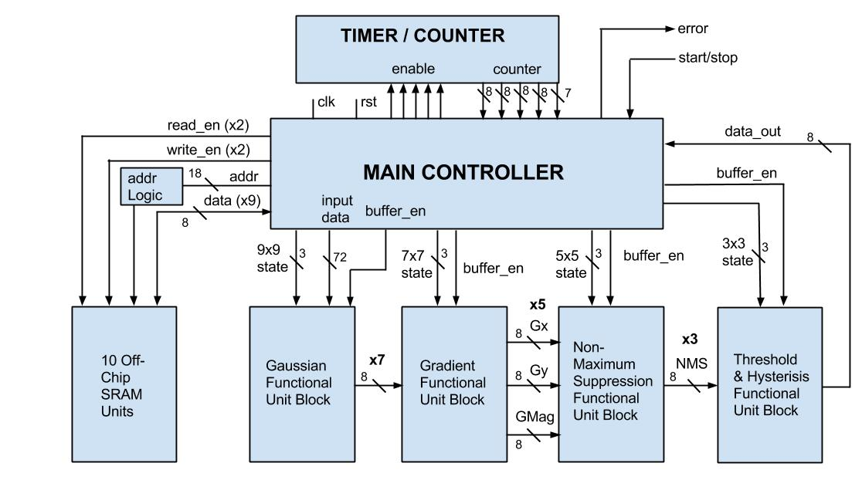
Architecture Diagram

Slide 6
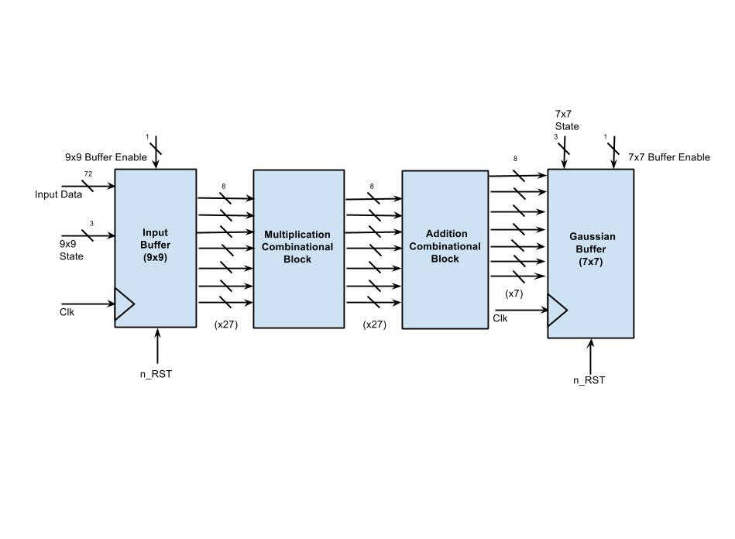
Image Smoothing (Gaussian)

Slide 7
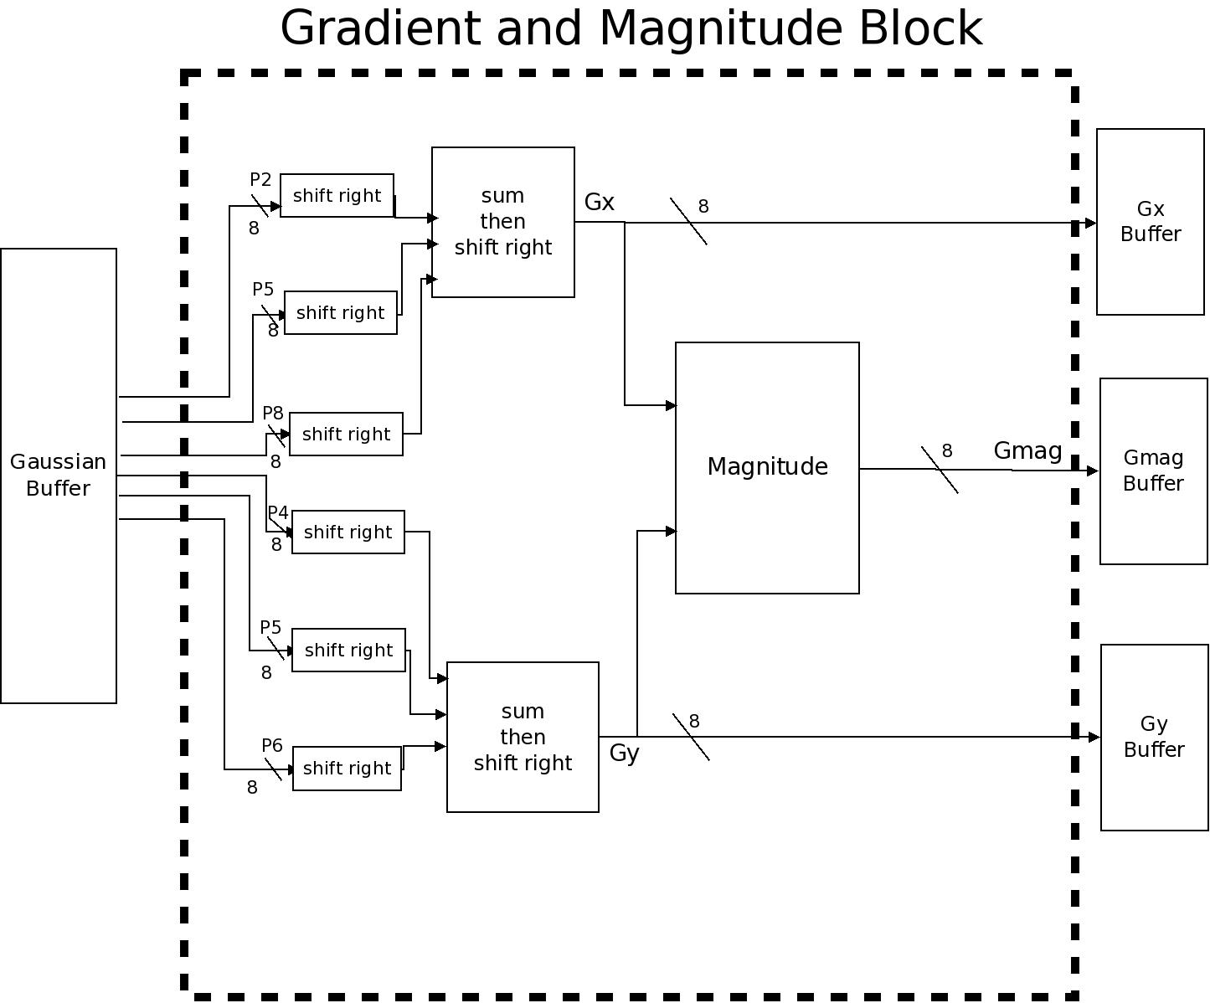
Gradient/Magnitude Calculation
x5

Slide 8
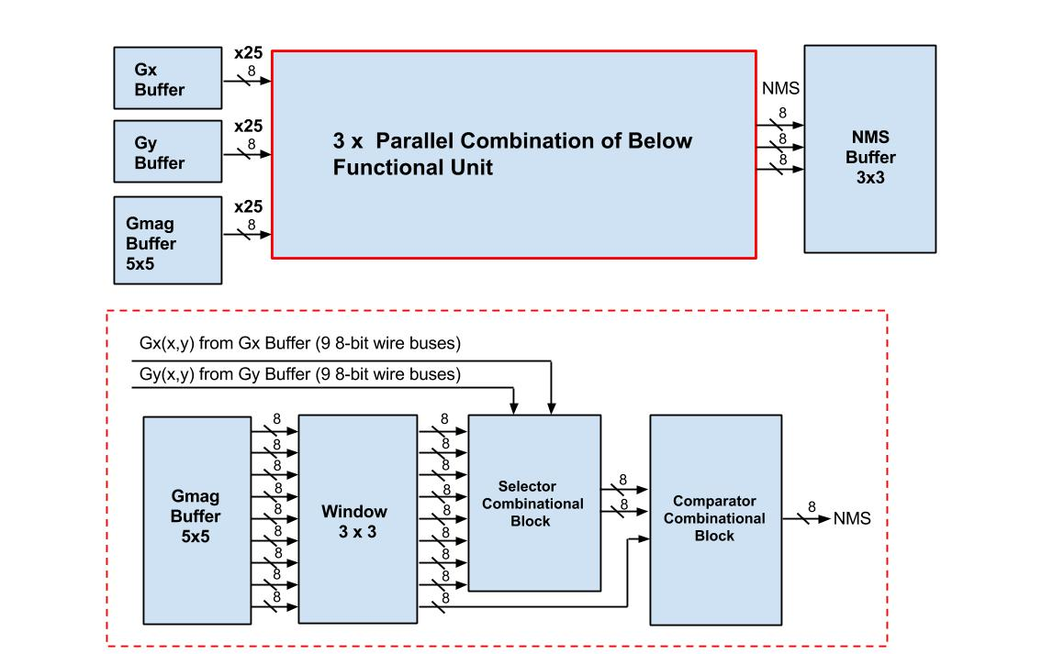
Directional Non-Maximal Suppression

Slide 9
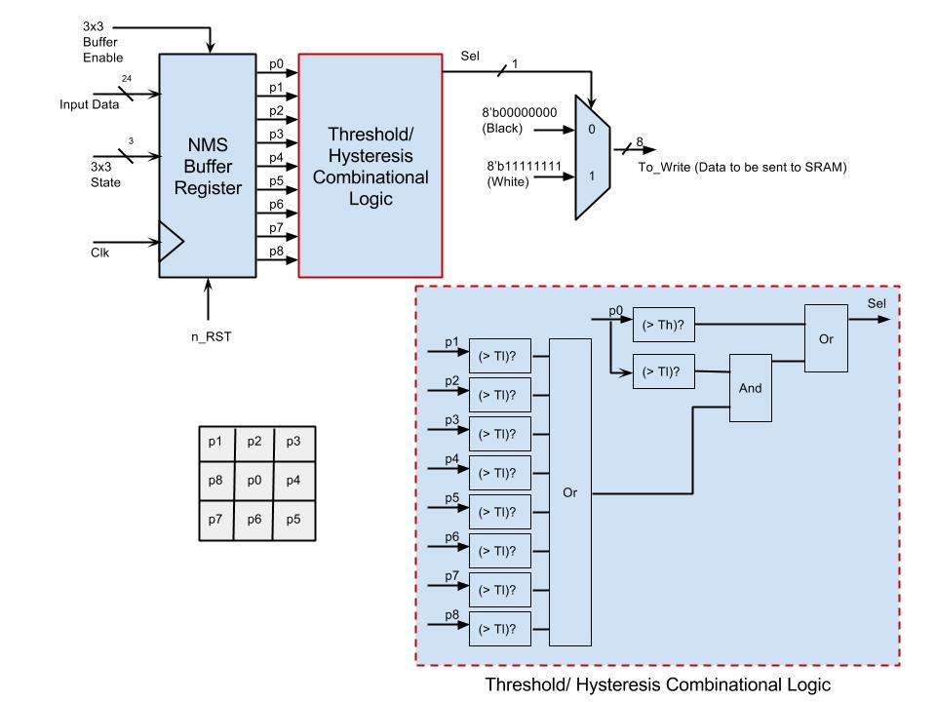
Hysteresis Thresholding

Slide 10
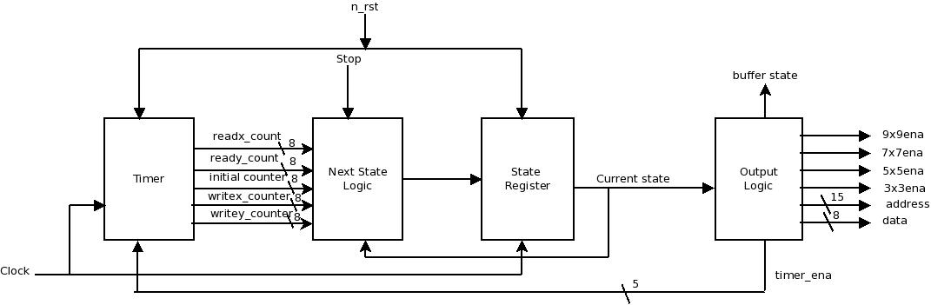
Main Controller RTL Diagram

Slide 11
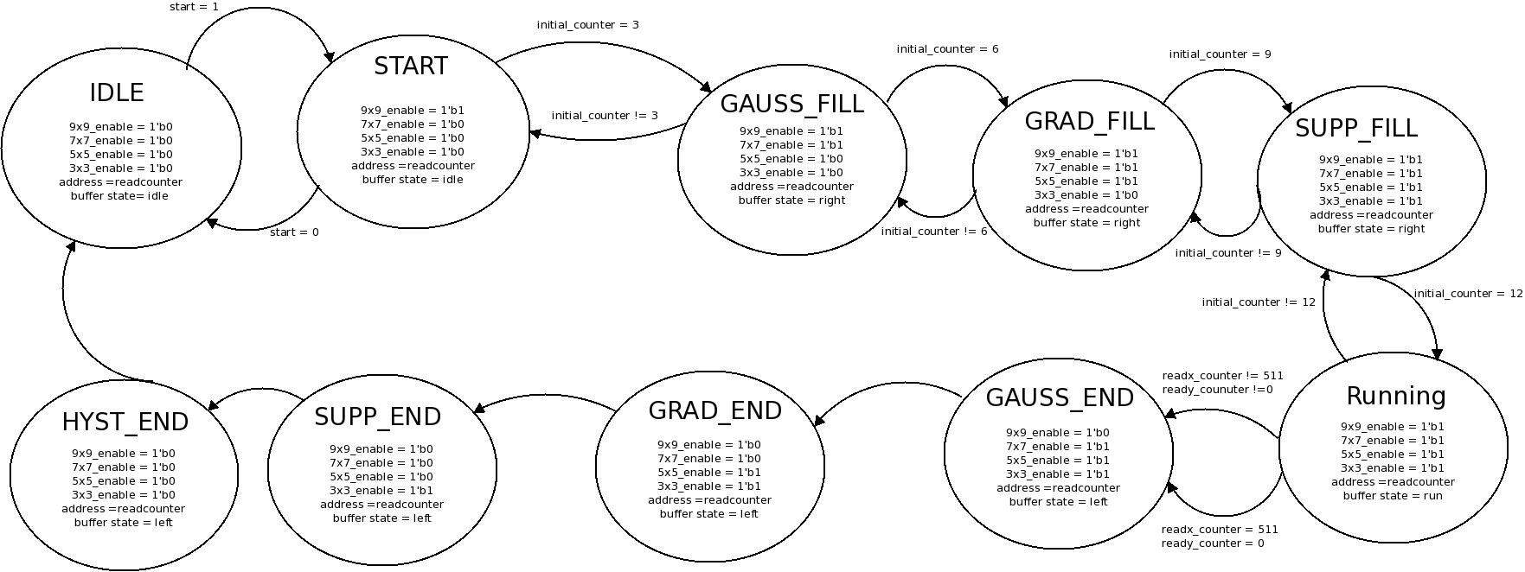
Main Controller State Diagram (Summary)

Slide 12
Area & Timing Budgets
Block Name | Gate/FF Count | Area (um²) | Total Path Delay (ns) | Target Clock Period (ns)
Gaussian (slide 6) | 1,944 | 2,527,200 | 5.2 | 10
Gradient/Mag (slide 7) | 3,432 | 3,220,800 | 6.2 | 10
Directional Non-Maximal Suppression (slide 8) | 3,480 | 3,600,00 | 3.2 | 10
Hysteresis Thresholding (slide 9) | 113 | 203,550 | 1.6 | 10
Main Controller and Timer (slide 11) | 106 | 224,700 | 10.2 | 10
Total Core Dimensions:
3,091x3,091 um²
Total I/O Padframe Dimensions:
2,805x2,805 um² (98 I/O pads)

